Slide 1

Industrial gas leakage monitoring system
JNTUH College of Engineering Manthani
Centenary Colony, Pannur(V), Ramagiri(M), Peddapally(D), Telangana-505212.
Department of computer science
Team Members
N.Prathul Sai(16VD1A0523)
B.Akhila(16VD1A0502)
D.Sai teja(16VD1A0538)
S.Navaneetha(16VD1A0519)
Under the guidance of
Mr.Y.Satyam
Asst.Prof(c)

Slide 2
Topics
Abstract
Problem Statement
Literature Survey
Existing Solution
Demerits
Proposed Solution
Design
Outcome
Conclusion

Slide 3
Abstract
Detection of poisonous gases in industries using cheap and reliable IoT sensors.
Preventing human, materialistic losses.

Slide 4
Problem Statement
Gas leakage in the industrial area causes many health issues. Every year there has been recorded no of deaths causing harm to humans as well as animals and birds.

Slide 5
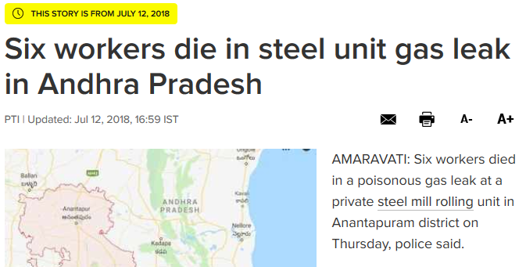
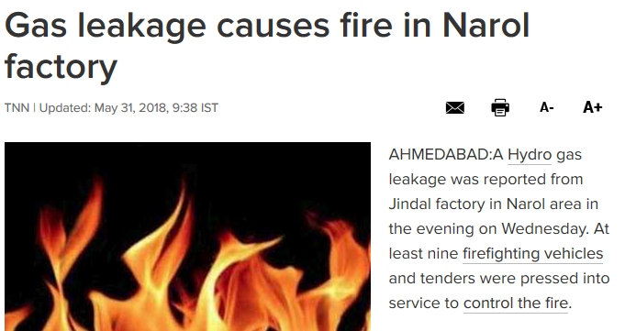
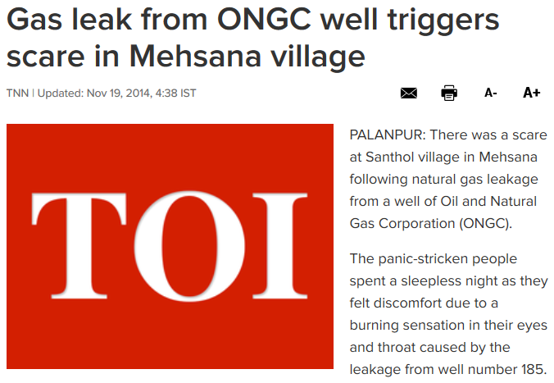
Literature survey

Slide 6
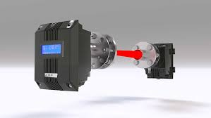
Existing Solution
Gas detection with laser
Robotic insects

Slide 7

Demerits
When heavy dust , steam or fog blocks the laser beam , the system will not able to take measurements.
This method is very costly so it is always ignored by small scale industries.

Slide 8
Proposed Solution
A monitoring system for gas leakage detection needs to be developed with the combustible gas sensor (MQ9) was used to detect the presence of methane (CH4) and carbon monoxide gas (CO).

Slide 9
Design
Components required
Arduino Uno board
MQ9 sensor
Bread board
ESP8266
Buzzer
Jumper wires

Slide 10
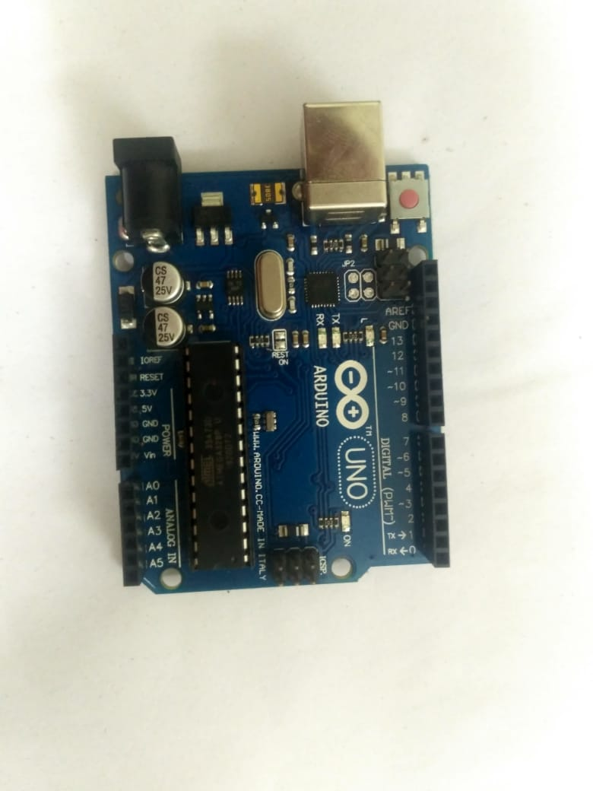
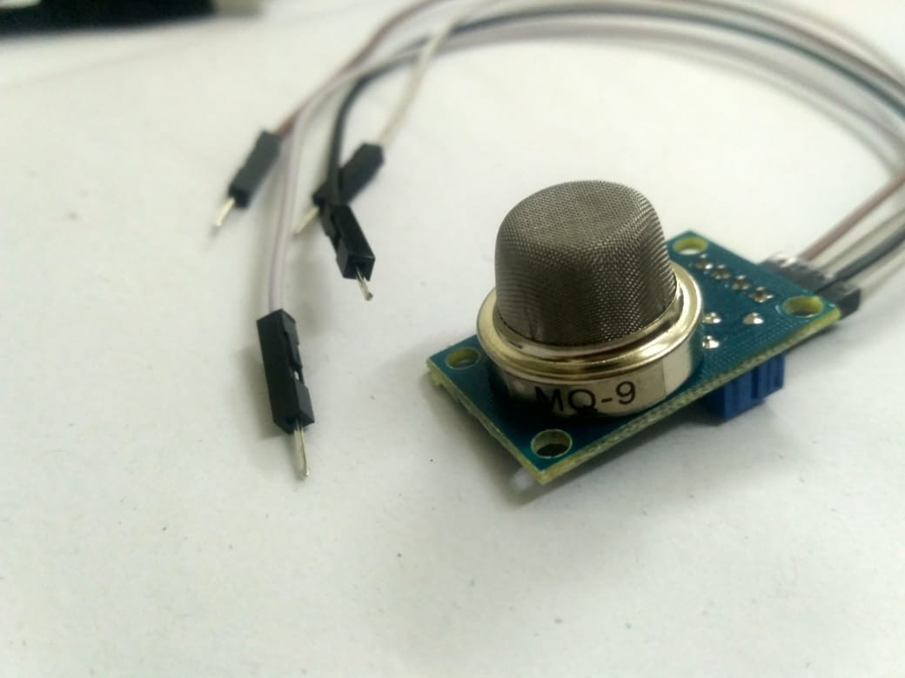
Arduino is an open-source platform.
It consists of both a physical programmable circuit board and a piece of software, or IDE that runs on your computer, used to write and upload computer code to the physical board.
It is a device that detects the one or more types of gas in the environment.
This sensor measures the concentration of gas.

Slide 11
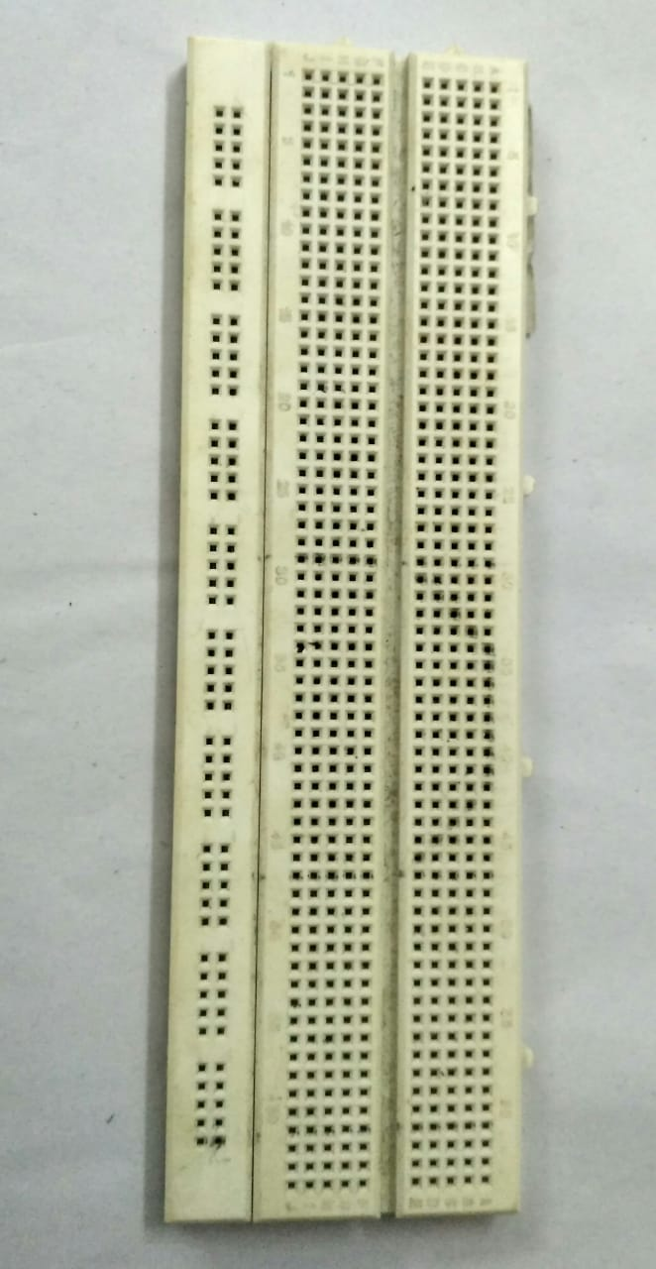
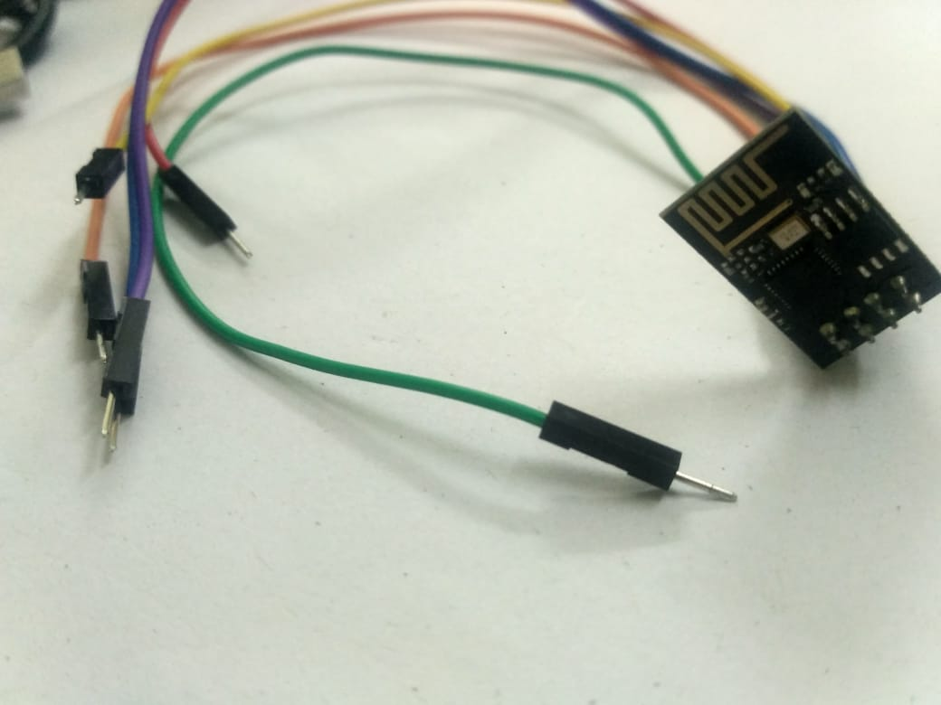
A breadboard has many holes into which circuit components like IC’s and resistors can be inserted.
The ESP8266 wifi module is self contained SOC with integrated TCP/IP protocol stack that can give any microcontroller access to WIFI network.

Slide 12
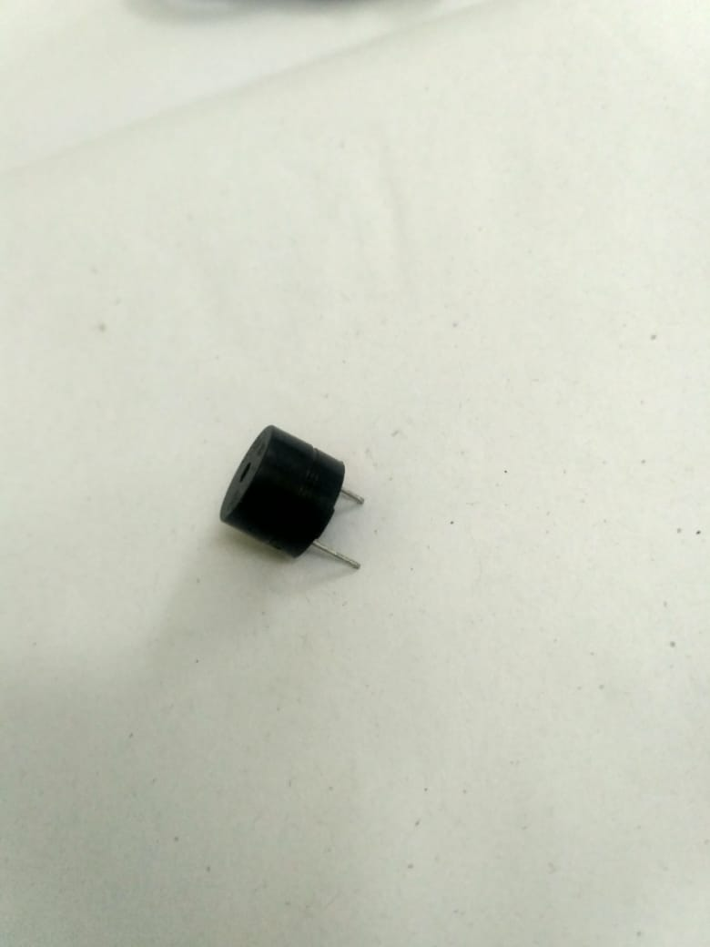
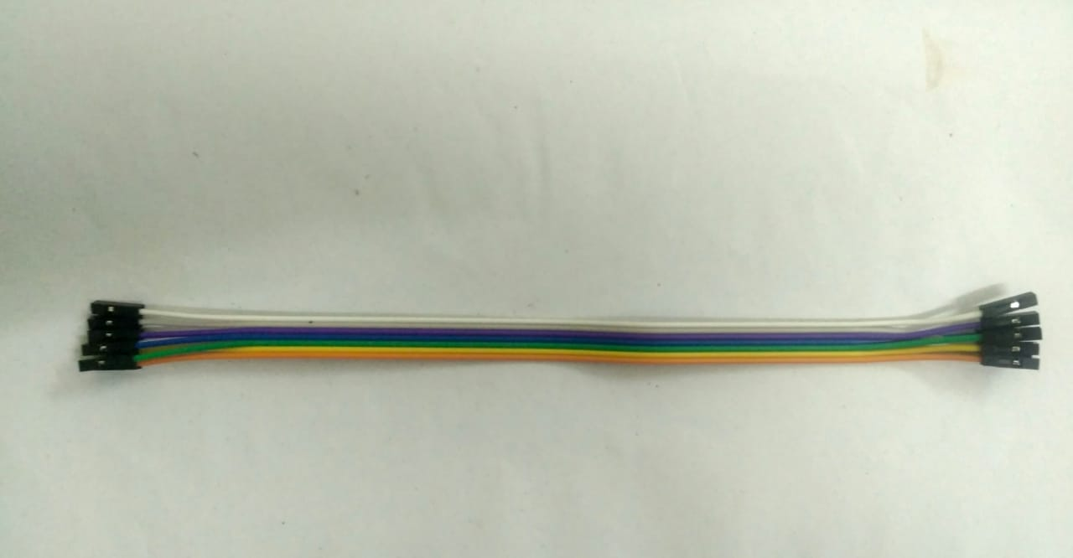
Jumper wires are used to establish an electrical connection between two points in a circuit.
A buzzer is a audio signalling device

Slide 13
Languages used
C
Php
Html
Css

Slide 14
Modules
Hardware implementation
User interface

Slide 15
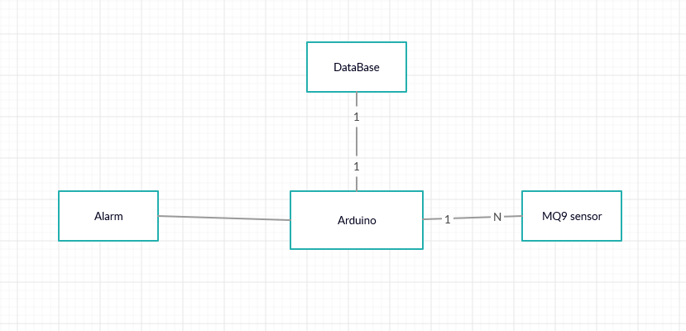
Hardware implementation

Slide 16
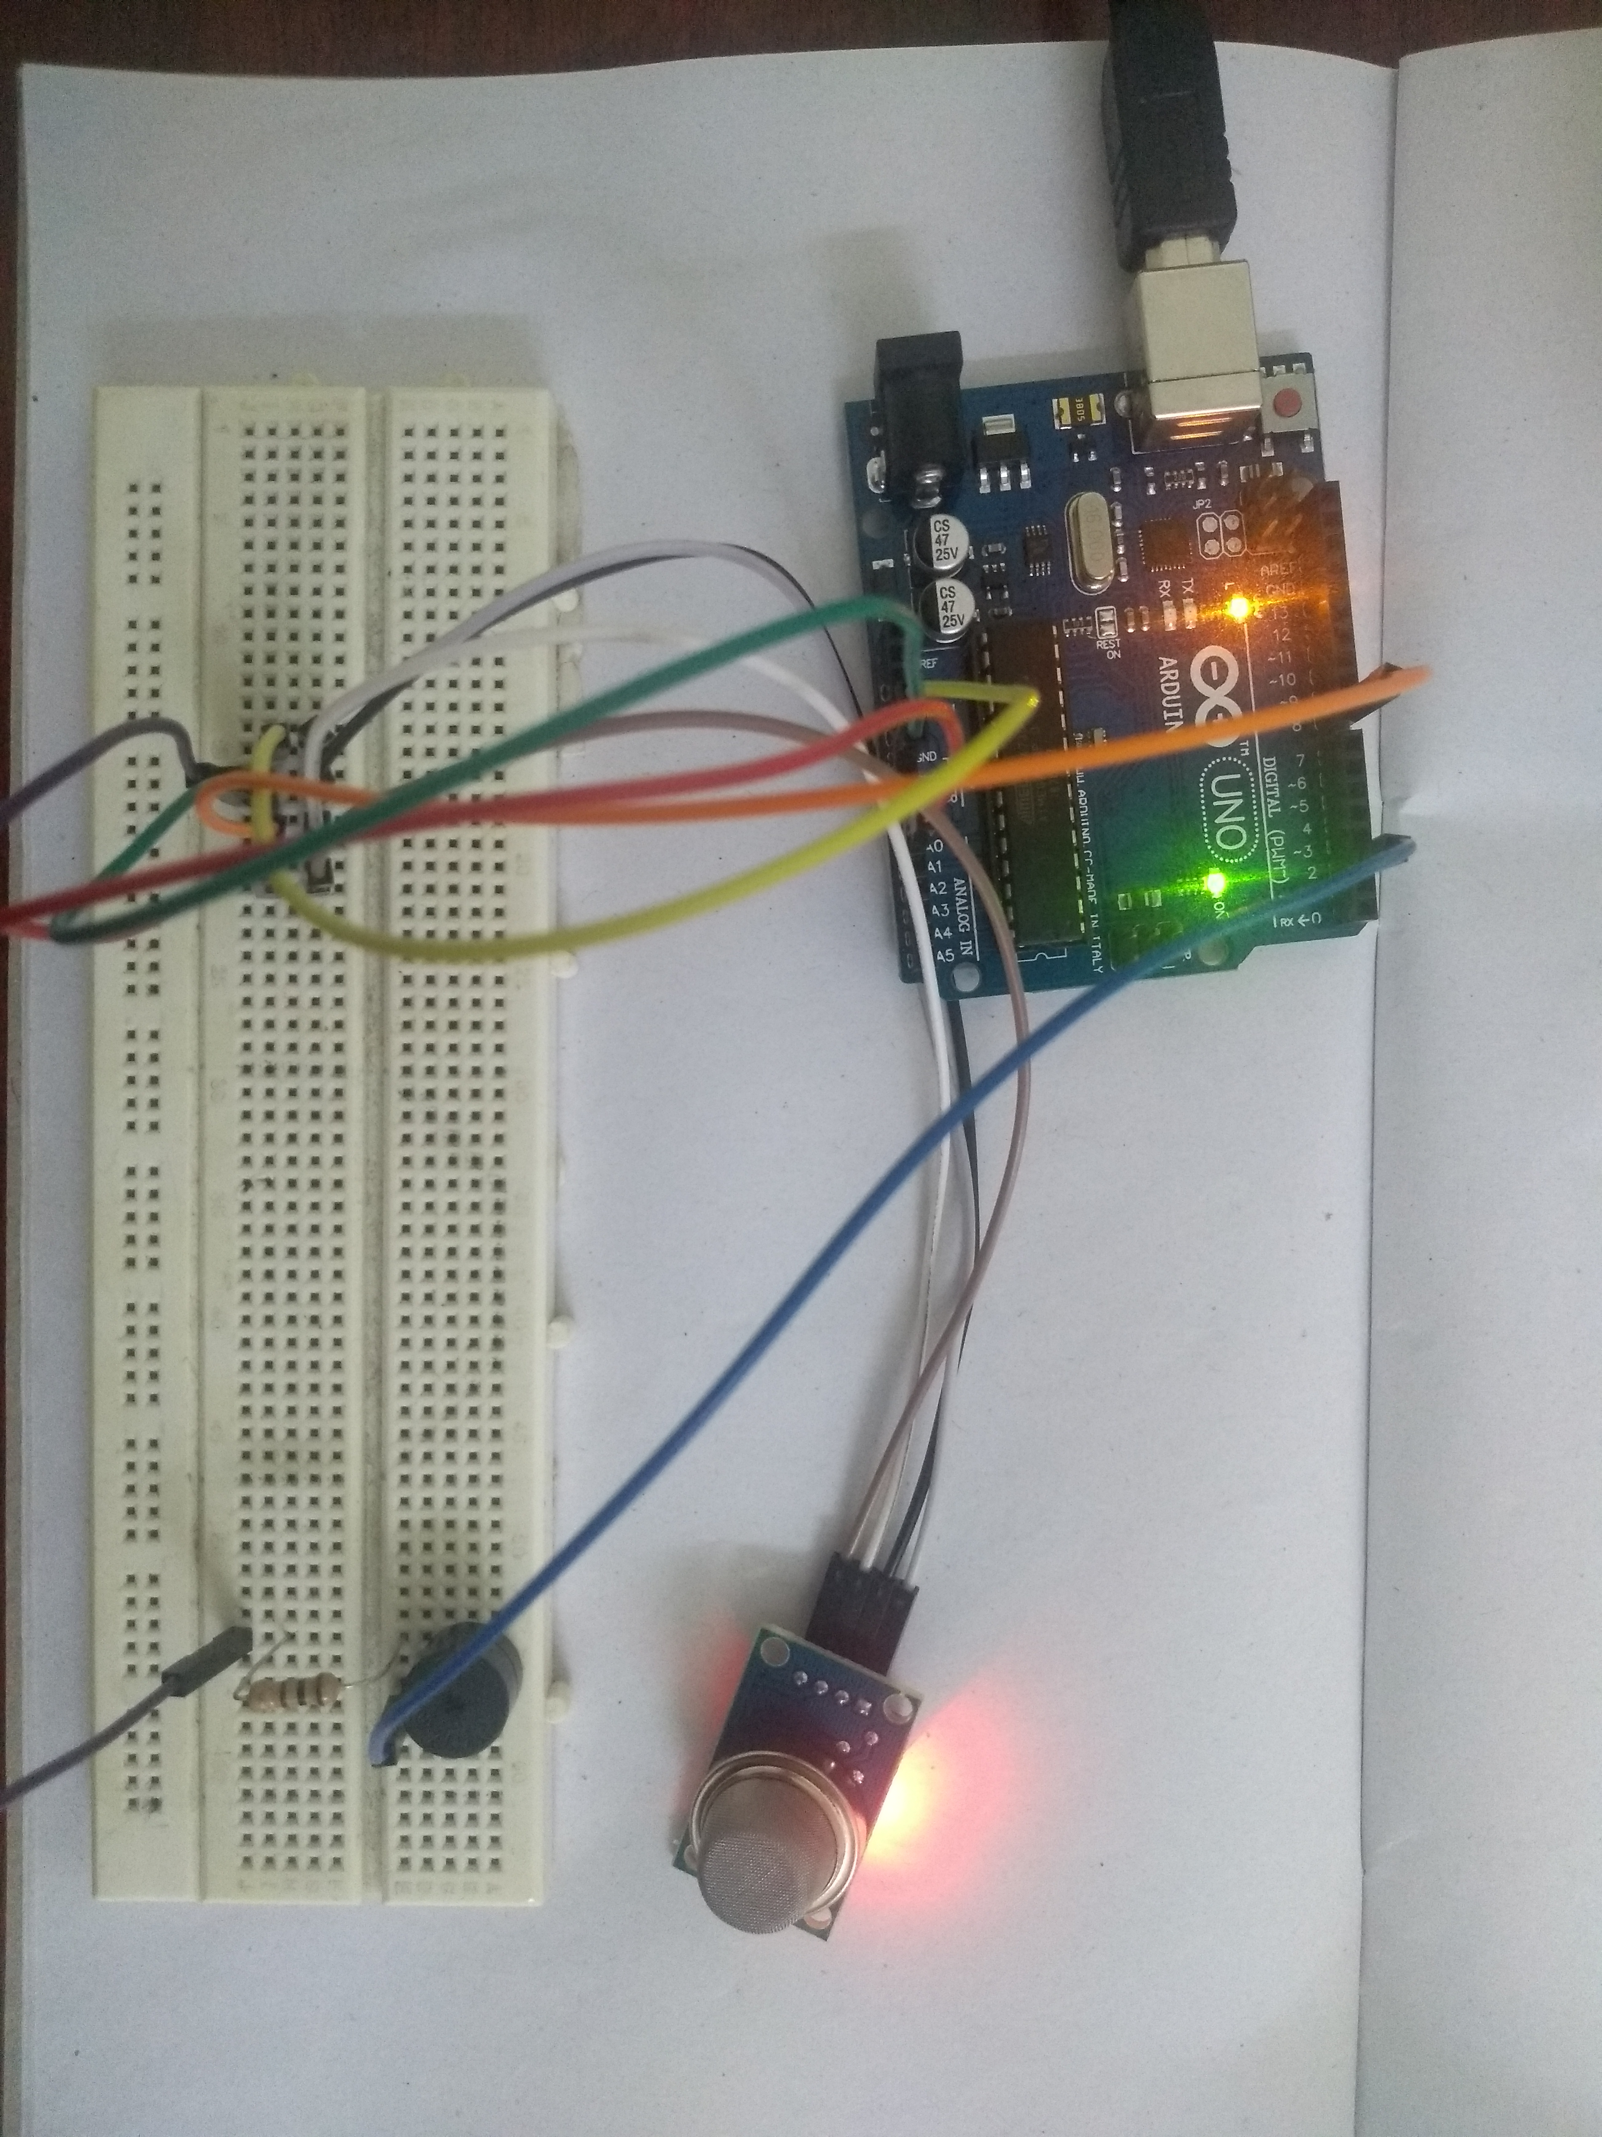
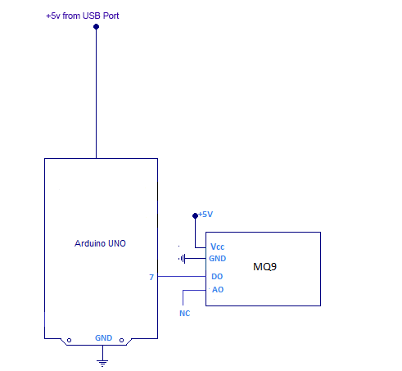
Circuit diagram

Slide 17
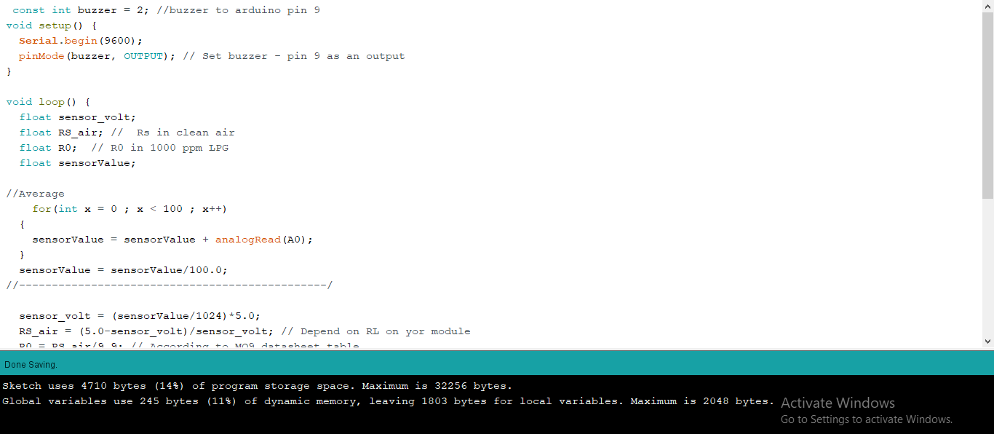
Code

Slide 18
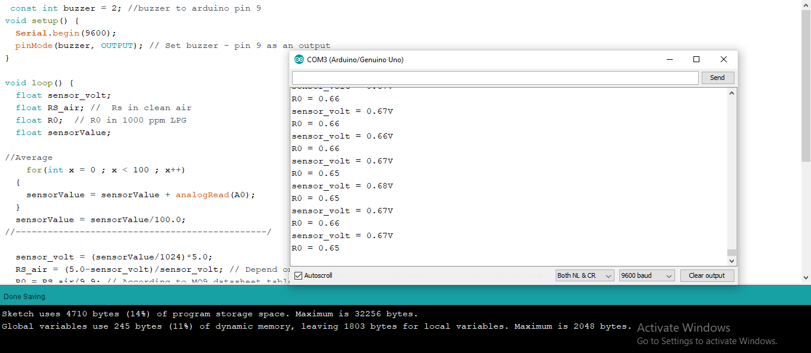

Slide 19
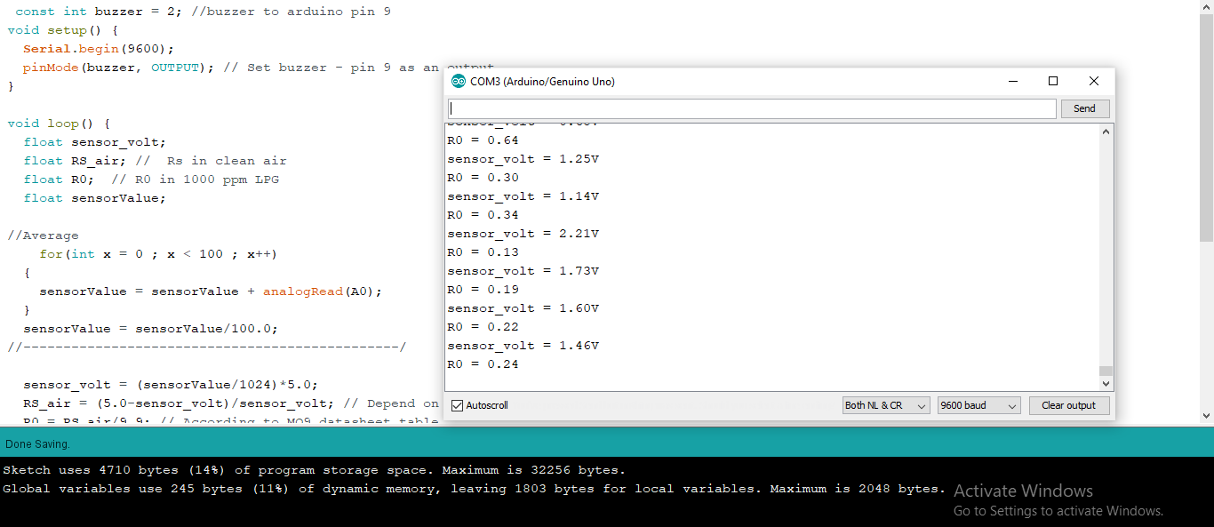
Outcome

Slide 20
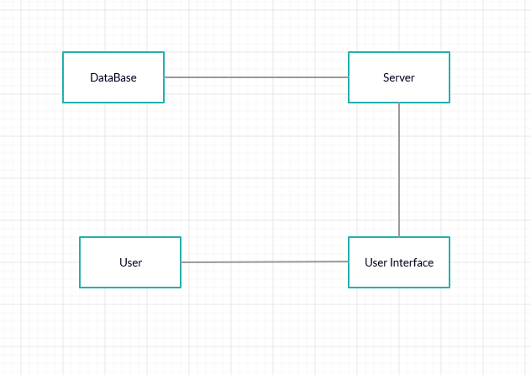
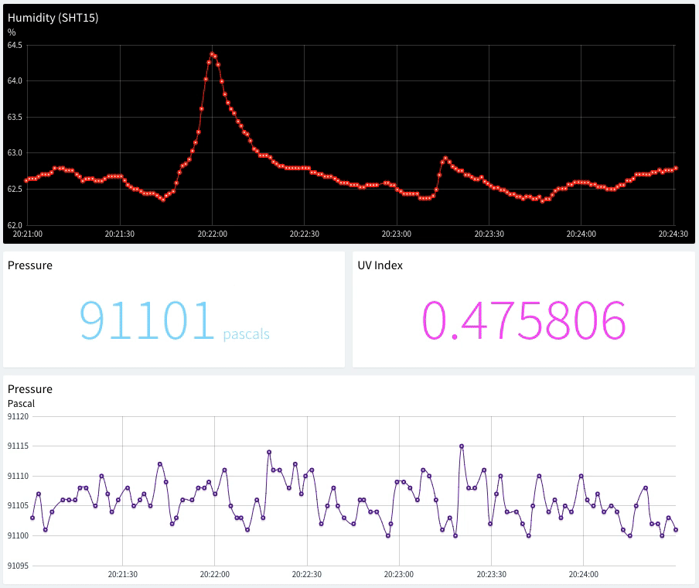
User Interface

Slide 21
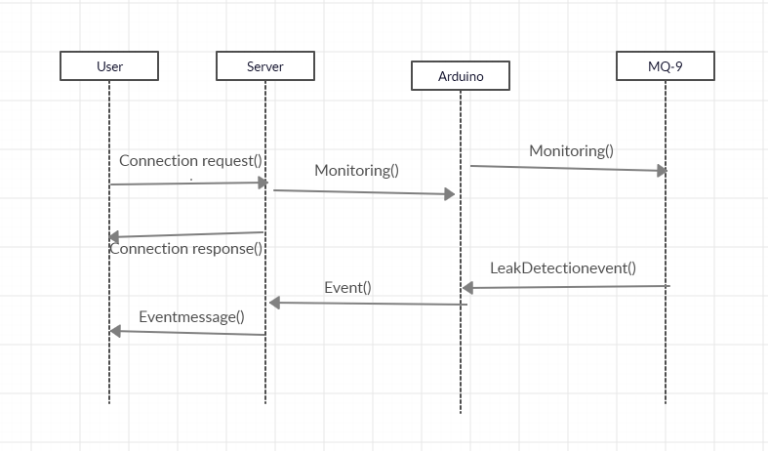
Sequence Diagram

Slide 22
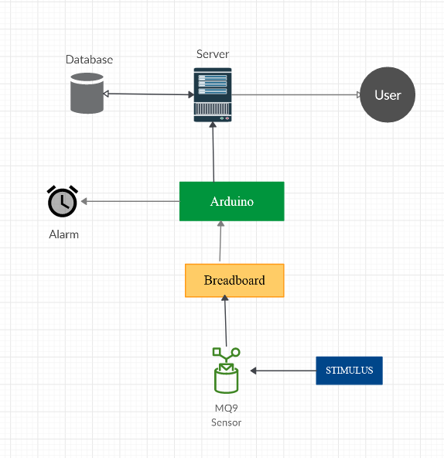
Data flow diagram

Slide 23
Conclusion
Gas leakage leads to severe accidents resulting in material losses and human injuries.
Hence, leakage detection is essential to prevent accidents and to save human lives.
This is an cost efficient way to detect harmful gases. and this device is portable so can be used in Industries,home,car.

Slide 24
References
Images referenced from google images
https://en.wikipedia.org/wiki/List_of_industrial_disasters
http://www.indiaenvironmentportal.org.in/category/2543/thesaurus/gas-leakages/?page=3

Slide 25

Any queries ?

Slide 26
Thank you !

